Slide 1

Analytics Olympiad ‘21
Business Outcome Presentation
Arka Ghosh
arkaghosh.nb@gmail.com

Slide 2
Data Understanding
Presenting a detailed overview of the data.
Important points:
Size and dimensionality of data
Important summary statistics of the variables (including distribution of target variable)?
Details of blank / null values and outliers
Any other important point, as observed by the team

Slide 3
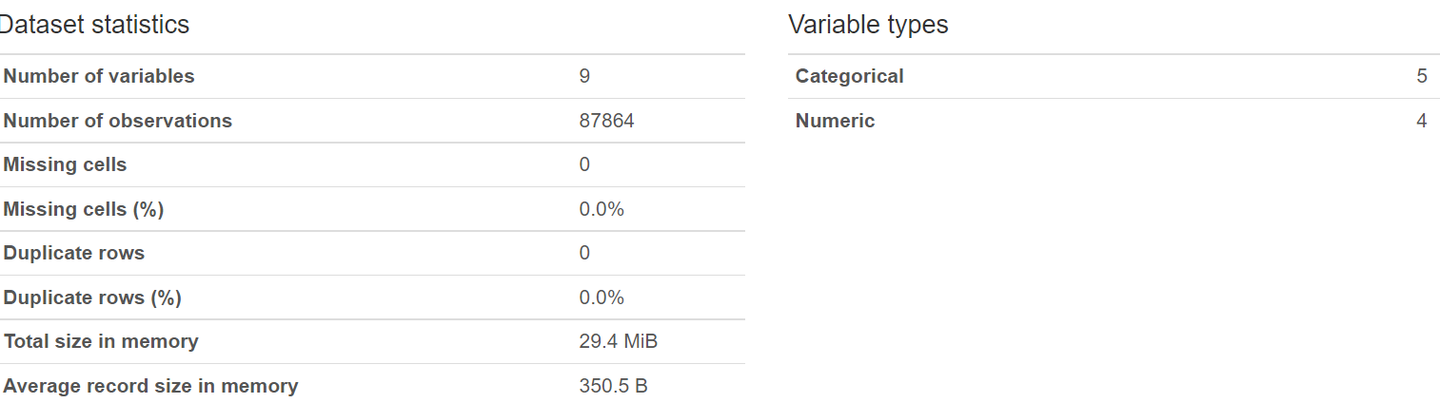
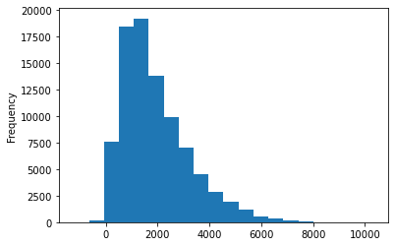
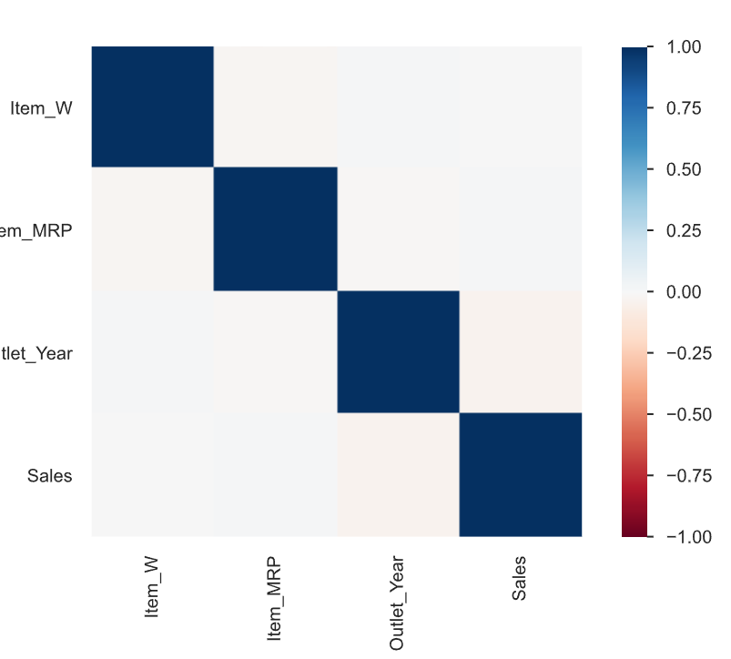
Data Understanding
Summary Statistics[Train]
A correlation matrix to verify if there is any particular feature that has a high degree of association(positive or negative) with Sales.
Sales data is not normally distributed, so we will use non-parametric statistical tests.
Skewness : 1.1313

Slide 4
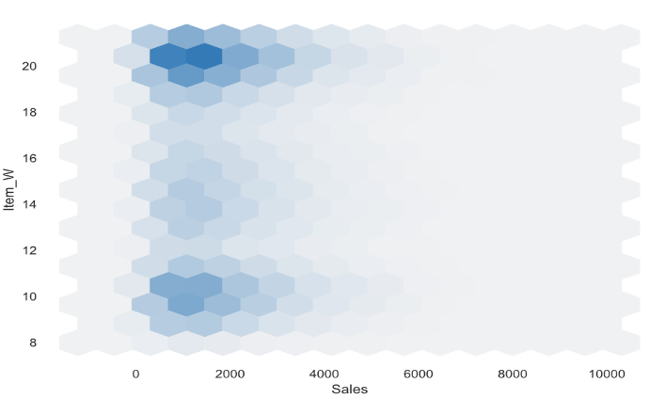
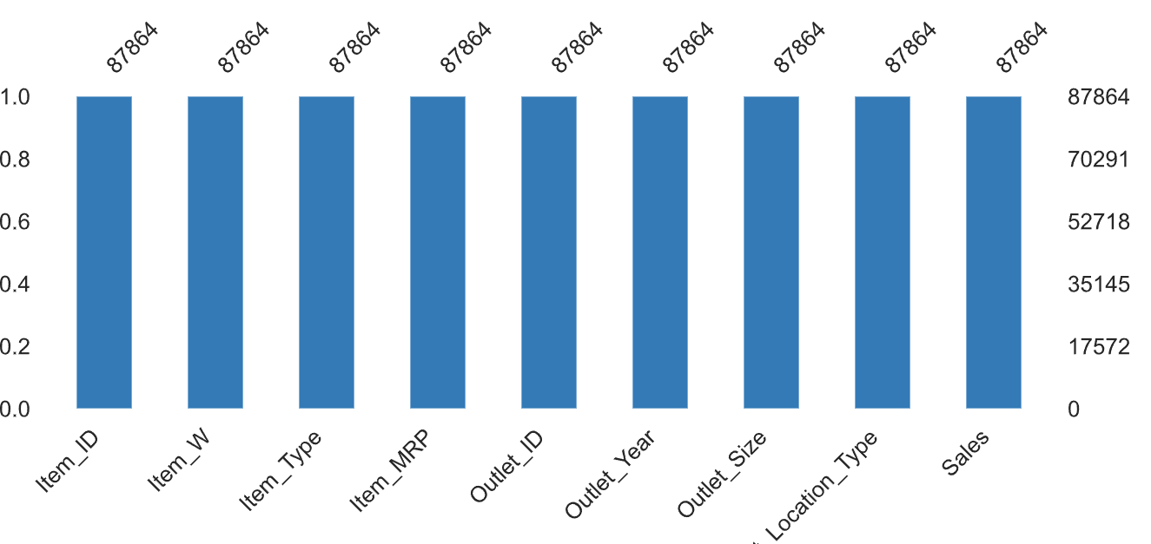
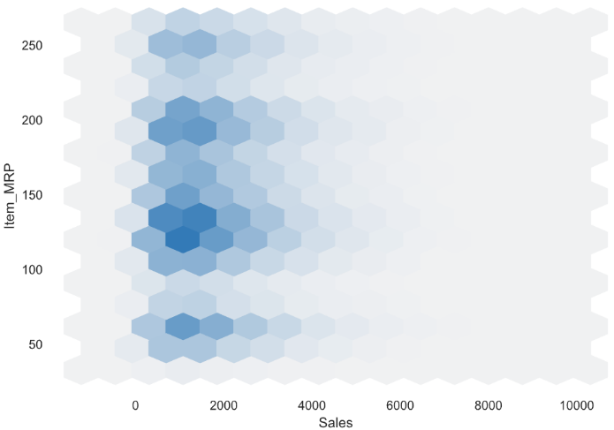
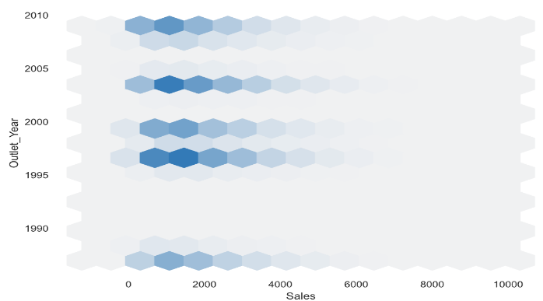
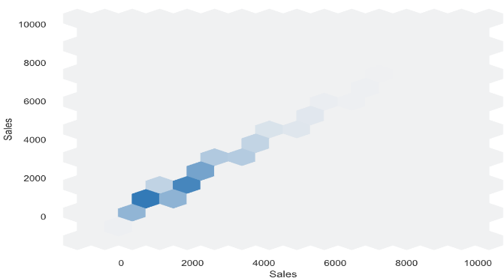
Data Understanding
Plot Interactions with Sales
Check Missing values or NAs - None

Slide 5
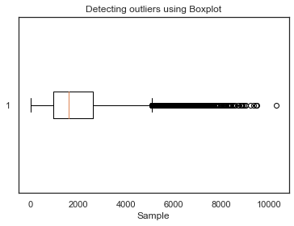
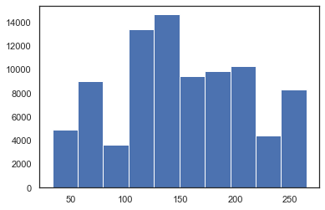
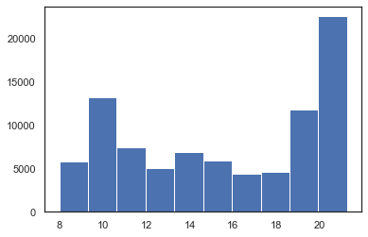
Data Understanding
Skewness for Item_MRP : 0.055660346208835934
Outlier Handling by Winsorization
Handle outliers by replacing values above/below a certain threhold with the threshold
Here, we have taken the lower and upper thresholds to be 1% and 99%.
Skewness for Item_W : -0.17953093828329283
IQR method of outlier detection
Calculate the interquartile range for the data.
Multiply the interquartile range (IQR) by 1.5 (a constant used to discern outliers).
Add 1.5 x (IQR) to the third quartile. Any number greater than this is a suspected outlier. Subtract 1.5 x (IQR) from the first quartile. Any number less than this is a suspected outlier.

Slide 6
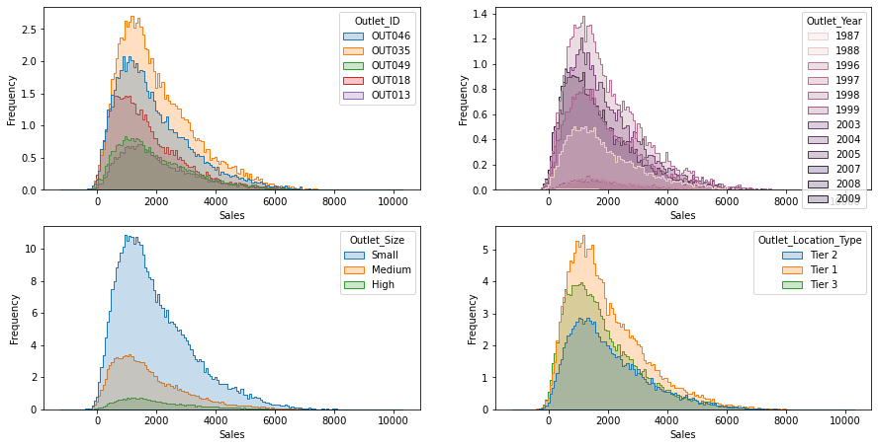
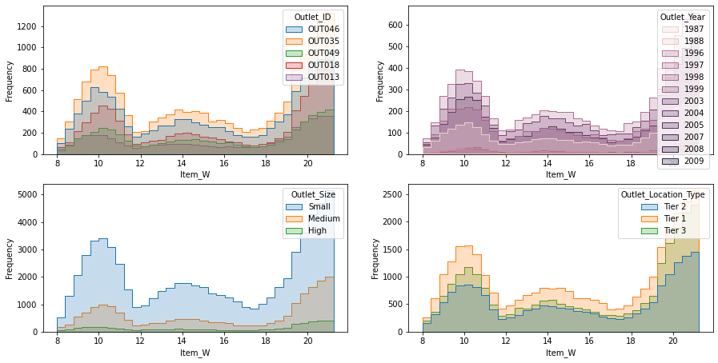
Data Understanding
We have created a histogram with 20 bins for Sales. Most frequent occurrence is the range between Rs.1000-2000. This means that maximum products that are being sold fall in this range. Beyond this , the frequency of sales is on a downward slope. Next, we plot the frequency charts of Sales as per Outlet_ID, Outlet_Year, Outlet_Size and Outlet_Location_Type.
We have created a histogram with 20 bins for Item Weight. Most frequent occurrence is when the items weighs 10, 14 and 22. This means that maximum item-weights of products that are being sold fall in this range. Beyond this , the frequency of Item Weight can vary. Next, we plot the frequency charts of Item Weight as per Outlet_ID, Outlet_Year, Outlet_Size and Outlet_Location_Type.

Slide 7
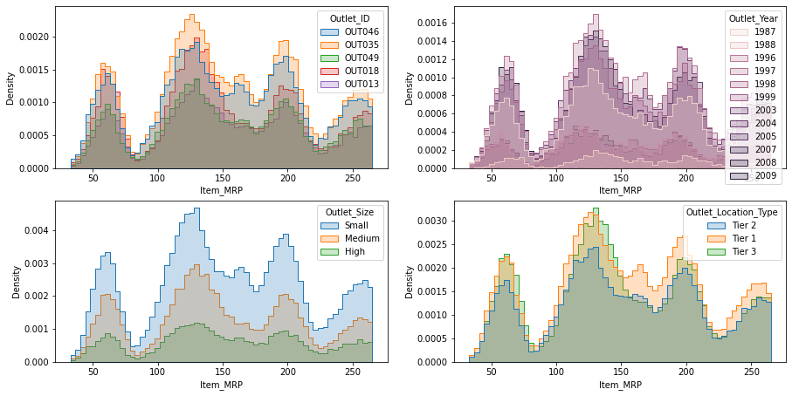
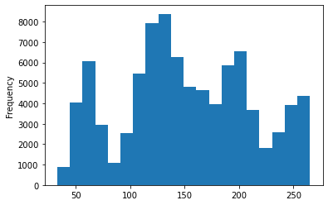
Data Understanding
We have created a histogram with 20 bins for Item MRP. Most frequent occurrence is when the items MRPS is around 60, 125 and 200. This means that maximum item-MRP of products that are being sold fall in this range. Beyond these values, the MRP can vary. Next, we plot the frequency charts of Item MRP as per Outlet_ID, Outlet_Year, Outlet_Size and Outlet_Location_Type.

Slide 8
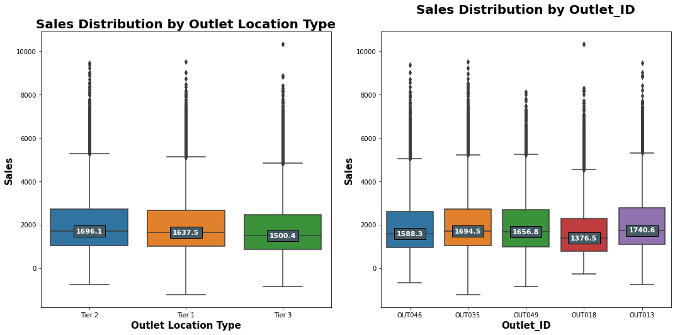
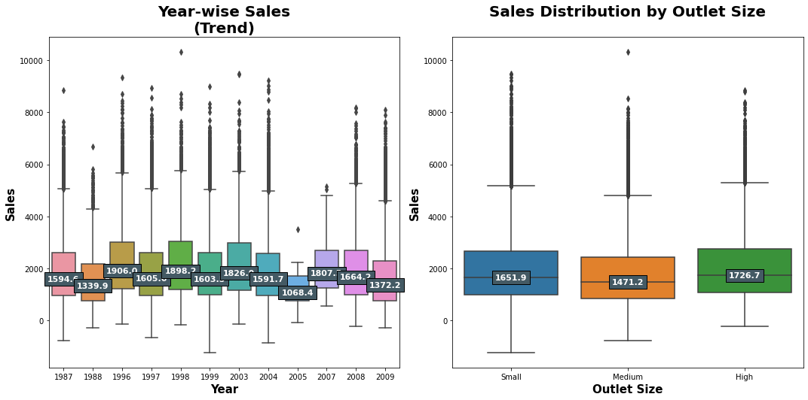
Data Understanding
We plot Sales numbers to check 2 KPI : Sales Distribution by Outlet Location Type and Sales Distribution by Outlet_ID. The numbers here indicate the median values of Sales every year and by Outlet location & Id. Median sales was highest in the year 1996 and the lowest in 2005. Big outlets have maximum median sales and medium sized outlets have minimum median sales. Tier 2 cities have highest median sales and OUT013 had the highest median sales.
We plot Sales numbers to check 2 KPI : Year-wise Sales(Trend) and Sales Distribution by Outlet Size. The numbers here indicate the median values of Sales every year and by Outlet size. Median sales was highest in the year 1996 and the lowest in 2005. Big outlets have maximum median sales and medium sized outlets have minimum median sales. Tier 2 cities have highest median sales and OUT013 had the highest median sales.

Slide 9


Data Understanding
Anderson-Darling Test
Anderson-Darling Test is a statistical test that can be used to evaluate whether a data sample comes from one of among many known data samples, named for Theodore Anderson and Donald Darling.
Conclusion
Sample does not look Gaussian (reject Null Hypothesis H0)
Shapiro-Wilk Test
The Shapiro-Wilk test evaluates a data sample and quantifies how likely it is that the data was drawn from a Gaussian distribution, named for Samuel Shapiro and Martin Wilk.
Conclusion
One or more sample distributions(small_sales, medium_sales & high_sales) are not equal(reject H0)
One or more sample distributions(tier1_sales, tier2_sales, tier3_sales) are not equal(reject H0).
Kruskal-Wallis H Test
Relationship of Sales & Outlet Size (p=0.0000 )
Relationship of Sales & Outlet Location Type (p=0.0000 )

Slide 10
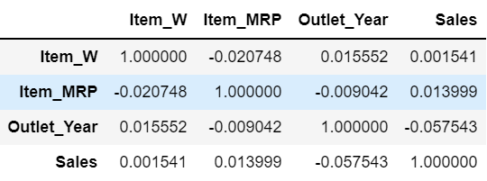
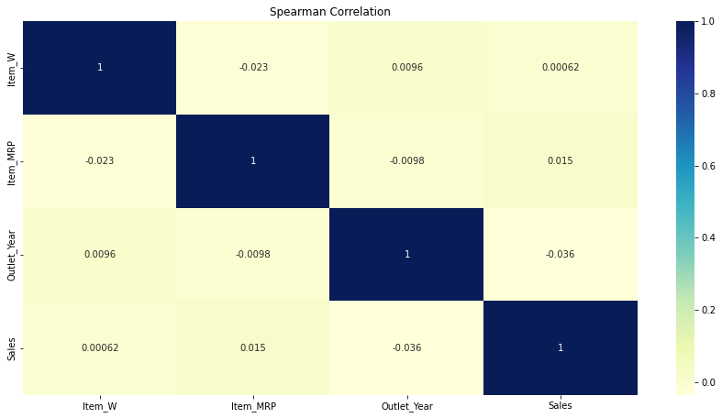
Data Understanding
Spearman Rank Correlation with Sales
There is a -negative correlation between Sales & Item_MRP implying that when prices are low, sales tend to be higher.
There is a negative correlation between Item_MRP & Outlet_Year implying that in earlier days prices were relatively higher than recent times.

Slide 11
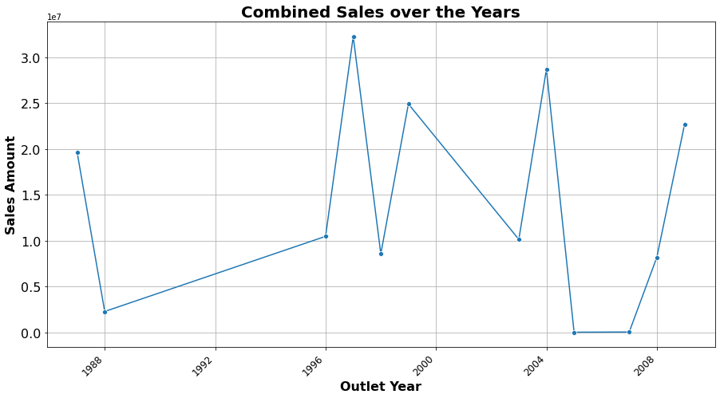
Data Understanding
Times Series Analysis
Time series analysis is a specific way of analyzing a sequence of data points collected over an interval of time. In time series analysis, analysts record data points at consistent intervals over a set period of time rather than just recording the data points intermittently or randomly.
Here, we see that combined sales amount varied a lot over the years although in 2005 there was a sharp drop followed by a steep increase in 2006-2007 period.

Slide 12
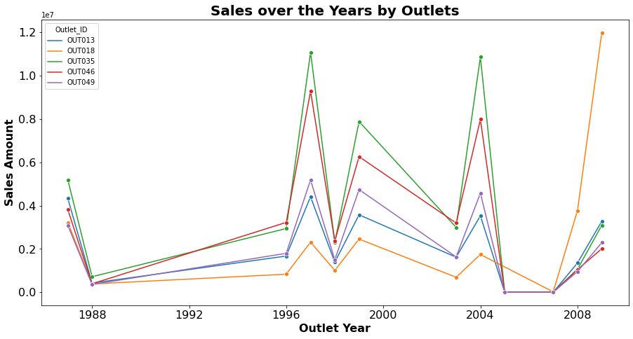
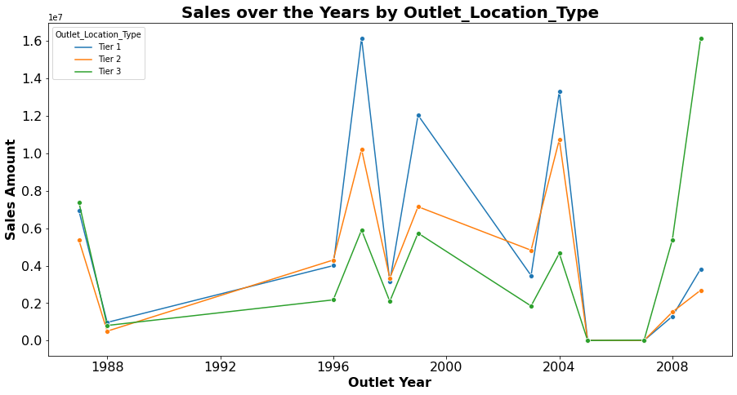
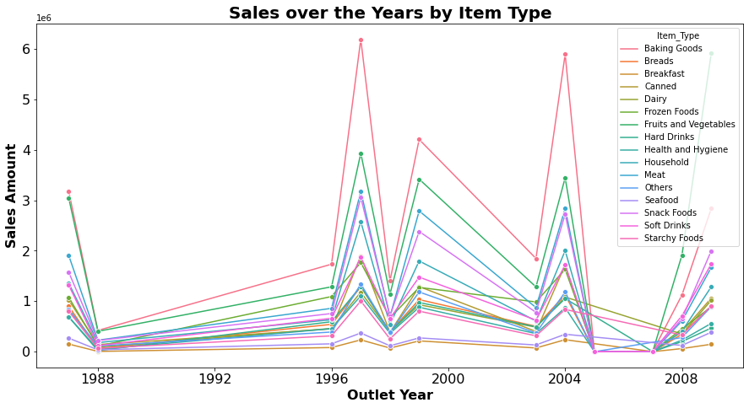
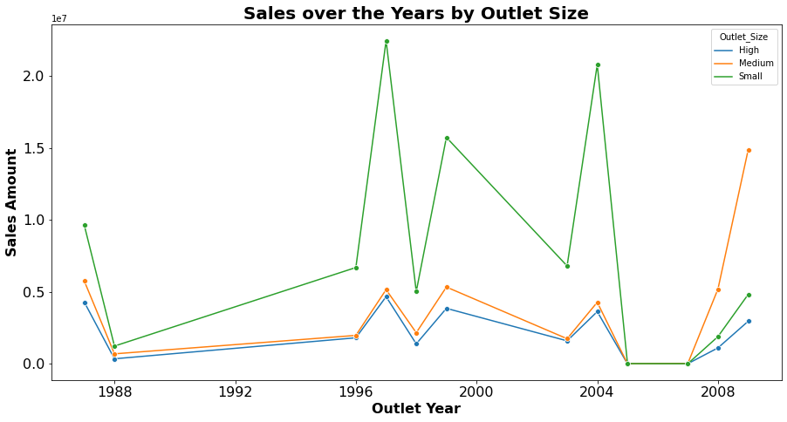
Data Understanding

Slide 13
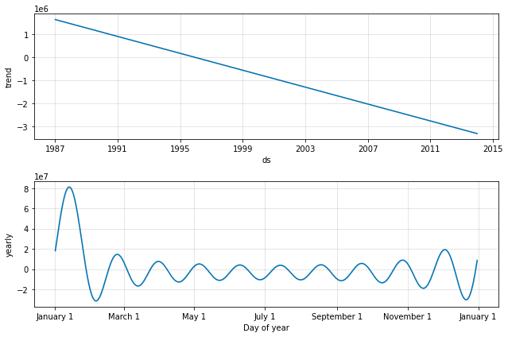
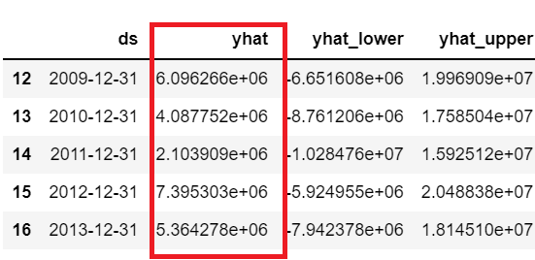
Data Understanding
Sales Forecast - Next 5 years
We will try to forecast the approximate sales value for the next 5 years based on Facebook’s Prophet algorithm. Prophet is a procedure for forecasting time series data based on an additive model where non-linear trends are fit with yearly, weekly, and daily seasonality, plus holiday effects.
Upcoming Trend
Here, we can see the trends with respect to year and cyclicity in a year. The first graph represents a strong decreasing trend as we progress through the 5 years from 2009 to 2013 and the latter shows a fluctuating trend in the monthly sales. For most months it is steady but towards the start of the year from January to February there is strong downward fluctuation

Slide 14
Data Preparation
Presenting how data was cleaned and prepared for building model.
Important points:
How missing values were handled?
How were the outliers handled?
Which new features / derived features were created from the data?
How was feature selection done?
Was binning required? If yes, why and how was it done?
Details of data partitioning
Any other important step used by the team

Slide 15
Data Preparation
Handle -ve sales numbers
We find there are some -ve sales values which is not clear. Negative sales number might mean that these are losses , however this is not clearly defined in the problem statement. First, we try by dropping the -ve sales records but its leads to reduced RMSE values. Finally, we found that by turning these -ve numbers to positive , we can get a marginally better RMSE.
Handle missing values
As shown earlier, we found no missing values in dataset. If there were any missing values, we would have imputed them with column mean or mode depending upon if it’s categorical or continuous.
Handle outliers
There are some outliers as identified by IQR method. We have tried to use percentile capping method to cap & floor the outliers to the 1% or 99% percentile values. While building models, we saw that in this case too much outlier removal is not helping improve the RMSE, so we kept the values.
Handle non-normal data
None of the numeric features are normally distributed. We have calculated the skewness of all such columns and they are not 0s. We have tried to do some conversions like log transformation, exponential transforations etc but it is not helping us improve the final RMSE score.
Handle Scaling/Standardization
For the numeric columns that are on different range, we have tried to use Min-Max scaling, Standard scaling and RobustScaling.

Slide 16
Data Preparation
Create the Outlet_Age based on Outlet_Year
In the given dataset, we have a feayure called Outlet_Year but this by itself is not going to be very useful
Create the Item_Group based on Item_Type
Here, we notice that Item-Type values can be grouped into some common categories of data like Drinks, Non Consumables and Food
We know that the age of an outlet can have some impact on the sales, an older more well known outlet might have more sales than a newer one.
Creating these new features help us better train the model in later stage.

Slide 17
Data Preparation
Categorical to Numeric Conversion
Many machine learning algorithms cannot operate on label data directly. They require all input variables and output variables to be numeric. Since we will be applying a regression algorithm, all the features must be numeric in nature. We can do it by converting the existing categorical columns by applying encoding.
Encoding | Feature
One-Hot Encode | Item_Type
Label Encode | Outlet_Size
Label Encode | Outlet_Location_Type
One-Hot Encode | Outlet_ID
One-Hot Encode | Item_Group
One-Hot Encode | Item_ID

Slide 18
Model Building & Evaluation
Presenting a detailed overview of model(s) used and the results observed.
Important points:
Which models were used? If a small number of models were used, why were they preferred over others? Which model gave the best performance?
Details of hyperparameter tuning for different models, particularly the most effective model (If relevant)
Comparison of results for different models (Both train and test data)
Explanation of the results (If an explanatory model like regression / trees were used)
Feature importance observed in different models
Important business insights coming from the models

Slide 19
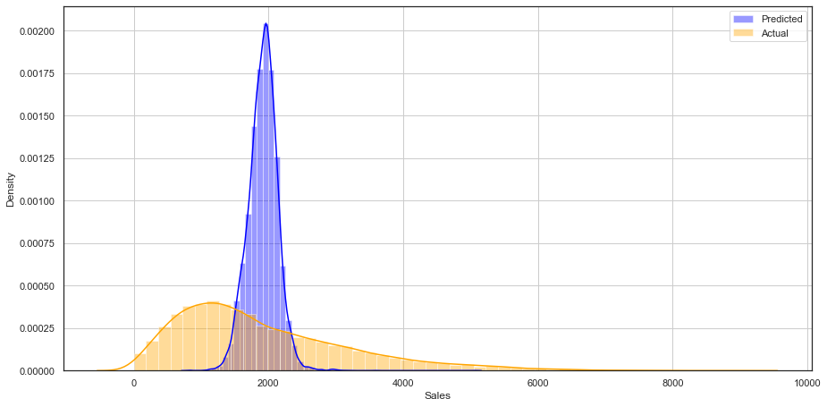
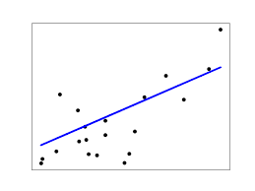
Model Building & Evaluation
We will implement some popular ML models and check their performance. The RMSE values are compared against those in the public leaderboard. Lastly, we will try out a stacked ensemble model using H2O library to give us the best performance metric.
Multivariate Linear Regression
Train
Root Mean Squared Error: 1273.09
R2 Score: 0.02809
Test
Root Mean Squared Error: 1285.84
R2 Score: -0.0013

Slide 20
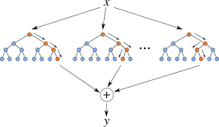
Model Building & Evaluation
Random Forest Regressor
Train
Root Mean Squared Error: 1040.87
R2 Score: 0.3503
Test
Root Mean Squared Error: 1285.84
R2 Score: -0.0013

Slide 21
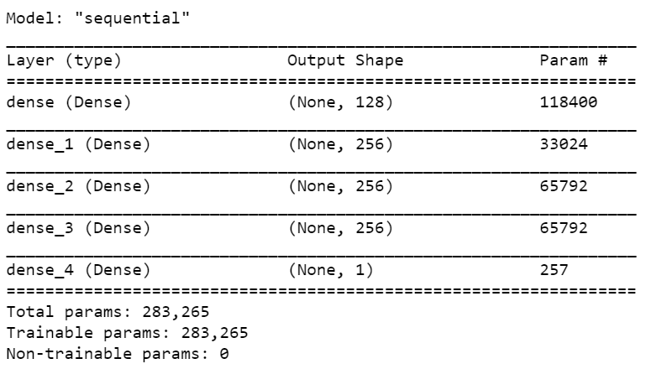
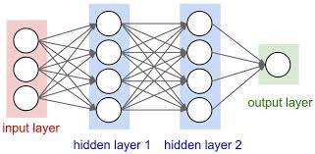
Model Building & Evaluation
Deep Neural Net Regressor
Train
Root Mean Squared Error: 1273.85
R2 Score: N/A
Test
Root Mean Squared Error: 1283.41
R2 Score: N/A

Slide 22
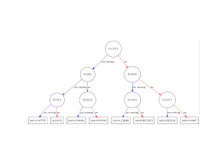
Model Building & Evaluation
XGBoost Regressor
Train
Root Mean Squared Error: 1217.39
R2 Score: 0.1129
Test
Root Mean Squared Error: 1287.29
R2 Score: -0.0013

Slide 23
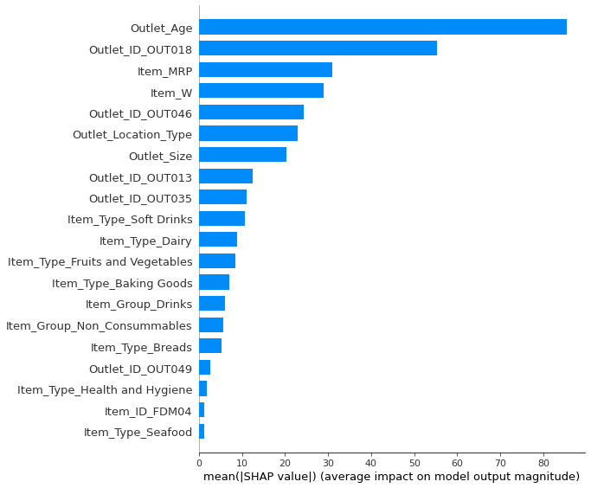
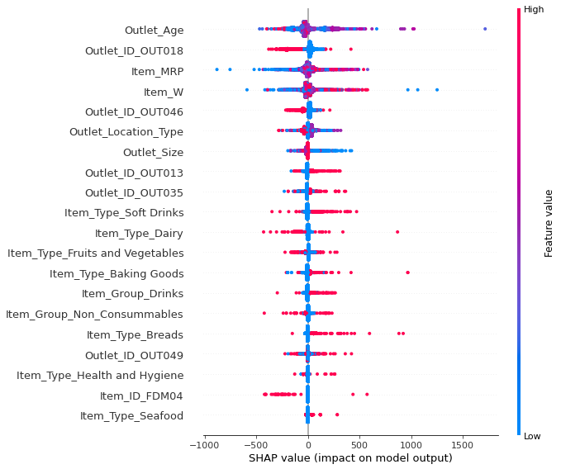
Model Building & Evaluation
XGBoost Feature Importance

Slide 24
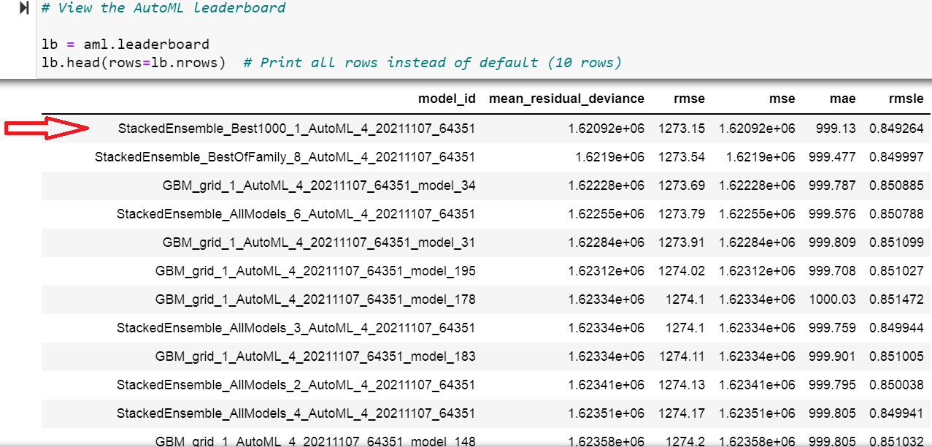
Model Building & Evaluation
Best Model: Stacked Ensemble Learning
Ensemble machine learning methods use multiple learning algorithms to obtain better predictive performance than could be obtained from any of the constituent learning algorithms. H2O’s Stacked Ensemble method is a supervised ensemble machine learning algorithm that finds the optimal combination of a collection of prediction algorithms using a process called stacking. Like all supervised models in H2O, Stacked Ensemble supports regression, binary classification, and multiclass classification.
StackedEnsemble_Best1000_1_AutoML_4_20211107_64351
** Reported on train data. ** | ** Reported on cross-validation data. **
MSE: 1616513.1736752875 | MSE: 1620921.740375437
RMSE: 1271.4217135456227 | RMSE: 1273.154248461449
MAE: 997.614318280515 | MAE: 999.1295029658132
RMSLE: 0.8488591943425776 | RMSLE: 0.8492642990325258
R^2: 0.052036319180277624 | R^2: 0.026072930599253752

Slide 25
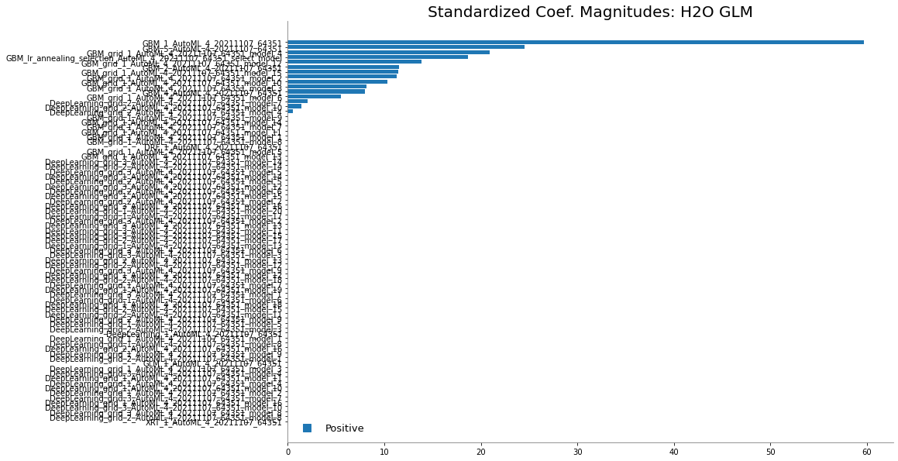
Model Building & Evaluation
Ensemble Exploration
To understand how the ensemble works, let's take a peek inside the Stacked Ensemble "All Models" model. The "All Models" ensemble is an ensemble of all of the individual models in the AutoML run. This is often the top performing model on the leaderboard
Examine the variable importance of the metalearner (combiner) algorithm in the ensemble. This shows us how much each base learner is contributing to the ensemble. The AutoML Stacked Ensembles use the default metalearner algorithm (GLM with non-negative weights), so the variable importance of the metalearner is actually the standardized coefficient magnitudes of the GLM.

Slide 26
Results and Recommendations
A summary of the important insights and results obtained and recommendations for deployment!
Important points:
Which of the developed models is best suited for deployment and why?
A summary of the innovative and new ideas proposed based on the analysis.
A summary of the important business outcomes /real life impact

Slide 27
Results & Recommendations
1. Sales data is not normally distributed.
There are no missing values in training set.
We created correlation matrix to study the numeric-numeric relationships.
There is no strong correlation to be found between Sales and other continuous features.
There is a -negative correlation between Sales & Item_MRP implying that when prices are low, sales tend to be higher.
There is a negative correlation between Item_MRP & Outlet_Year implying that in earlier days prices were relatively higher than recent times.
2. Sales data has some outliers defined by the Inter-Quartile Range method. We have viewed these outliers using standard box plot.
We have tried to apply percentile-based capping of 1% and 99% on these outliers.
However, removing these outliers completely does not necessarily improve the RMSE of our models.
3. We have created a histogram with 20 bins for 'Sales'. Most frequent occurrence is the range between Rs.1000-2000. This means that maximum products that are being sold fall in this range. Beyond this, the frequency of sales is on a downward slope.
4. We have created a histogram with 20 bins for 'Item_MRP'. Most frequent occurrence is when the items MRPS is around 60, 125 and 200. This means that maximum Item-MRP of products that are being sold fall in this range.
5. We plotted ales numbers to generate 4 KPI : 'Sales Distribution by Outlet Location Type' ,'Sales Distribution by Outlet_ID',
'Year-wise Sales(Trend)' and 'Sales Distribution by Outlet Size'.
Median sales was highest in the year 1996 and the lowest in 2005.
Big outlets have maximum median sales and medium sized outlets have minimum median sales.
Tier 2 cities have highest median sales and OUT013 had the highest median sales.

Slide 28
Results & Recommendations
6. We plotted the sales data on a time series by year. We see that 'combined sales amount' varied around the Rs. 2000 mark all through the years, although in 2005 there was a sharp drop followed by a steep increase in 2006-2007 period. Similar behaviour can be seen when sales is plotted by Outlets,Outlet Location Type, Item Type and Outlet Size.
7. Using Facebook's prophet package we were able to build a timeseries model and predict sales for the next 5 years as follows.
This is the total sales figures across all data.
Year Predicted Sales Amount
2009 ₹ 6,096,266
2010 ₹ 4,087,752
2011 ₹ 2,103,909
2012 ₹ 7,395,303
2013 ₹ 5,364,278
8. In our regression models (XGBoost), we found the features that are of most importance and have significant SHAP values.
Outlet_Age is the most important feature contributing to the prediction model of XGBoost.
Next 'Item_MRP' and 'Item_Weight' have significant impact on Sales.
9. We have tried building many machine learning models like Linear Regression, Random Forest Regressor, XGBoost Regressor and Deep Neural Net Regressor, these did not give us the best RMSE values. Among these base models, XGBoost was the best model. Given below is the performance metrics of all the models.
10. Finally, we applied H2O's Stacked Ensemble that uses multiple learning algorithms to obtain better predictive performance than could be obtained from any of the constituent learning algorithms. Ensemble machine learning methods use multiple learning algorithms to obtain better predictive performance than could be obtained from any of the constituent learning algorithms.

Slide 29
Results & Recommendations
Model Comparison
Top 5 Recommendations
 | Train |  | Test
Model | RMSE | R2 Score | RMSE | R2 Score
Multivariate Linear Regression | 1273.09 | 0.0281 | 1285.84 | -0.0013
Random Forest Regressor | 1040.87 | 0.3503 | 1285.84 | -0.0013
Deep Neural Net Regressor | 1273.85 | NA | 1283.41 | NA
XGBoost Regressor | 1217.39 | 0.1129 | 1287.29 | -0.0013
XGBoost Regressor(Hypertuned) | 1458.79 | -0.2737 | 1287.29 | -0.0013
**Stacked Ensemble Learning | 1271.42 | 0.05203 | 1273.15 | 0.02607
Keep MRP prices low as Sales tend to be higher
Sell more items whose MRP falls around Rs. 60, 125 and 200 mark.
Invest in bigger outlets in Tier 2 cities to increase sales
Outlet OUT013 has minimum sales, so offer discount on items here
Invest in renovating older outlets to attract customers
** Top scoring model
Conclusion
To deploy, it is recommended that Stacked Ensemble learning be applied that builds upon several base models like GBM, XGB etc.
Also, some key insights have been shared that can be applied to increase sales. The model can be deployed online if there is a AWS account via MLOps. Otherwise it can also be deployed on an On-Premise server. In future, more data features can be gathered for even better prediction of Sales.

